Slide 2
AI and cyber AI applications for EATM-CERT
Patrick MANA
EATM-CERT
10.11.2023

Slide 3
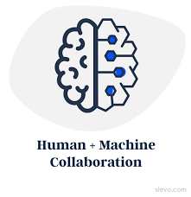
AI for cyber
Increase
productivity
Save resources
Focus on adding value
Challenge completeness
Conduct “undone/impossible”
analyses
Dedicated knowledge database

Slide 4
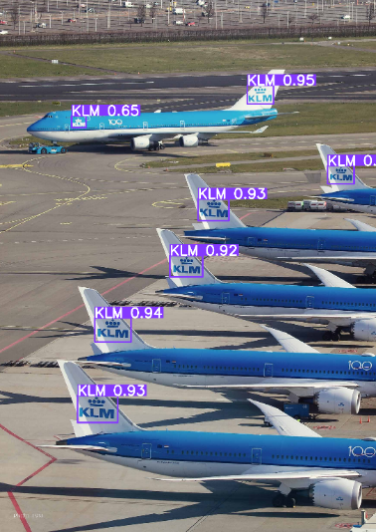
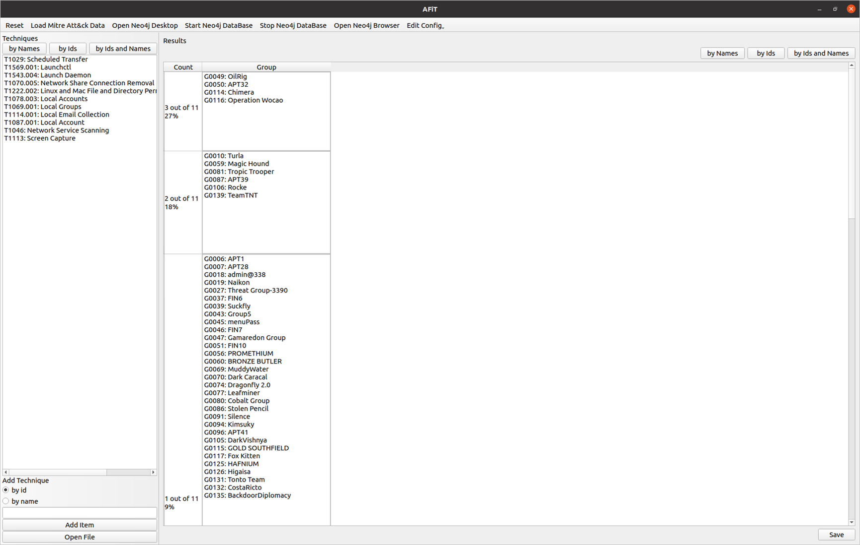
AI/ML app for cyber at EATM-CERT
Four app either under development or about to:
Aviation documents – COMPLETED
Available to aviation stakeholders
Password cracker – First part based on RNN, then Markov and GAN
Support pentest – done
Tool to check staff new password - soon
MITRE ATT&CK tool – Started 12/2022
Knowledge database: Dedicated LLM – started 07/2023

Slide 5
Simplified Threat Model
Aviation
State Sponsored
Hacktivists
Non-OPS
Cyber crime
Script kiddies
OPS
Finance & HR
Cyber crime
State sponsored
IPR
State sponsored
Hacktivists
Hacktivists
Hacktivists
State sponsored
Notes:
Giving an info about the model that we developed to understand the landscape

Slide 6
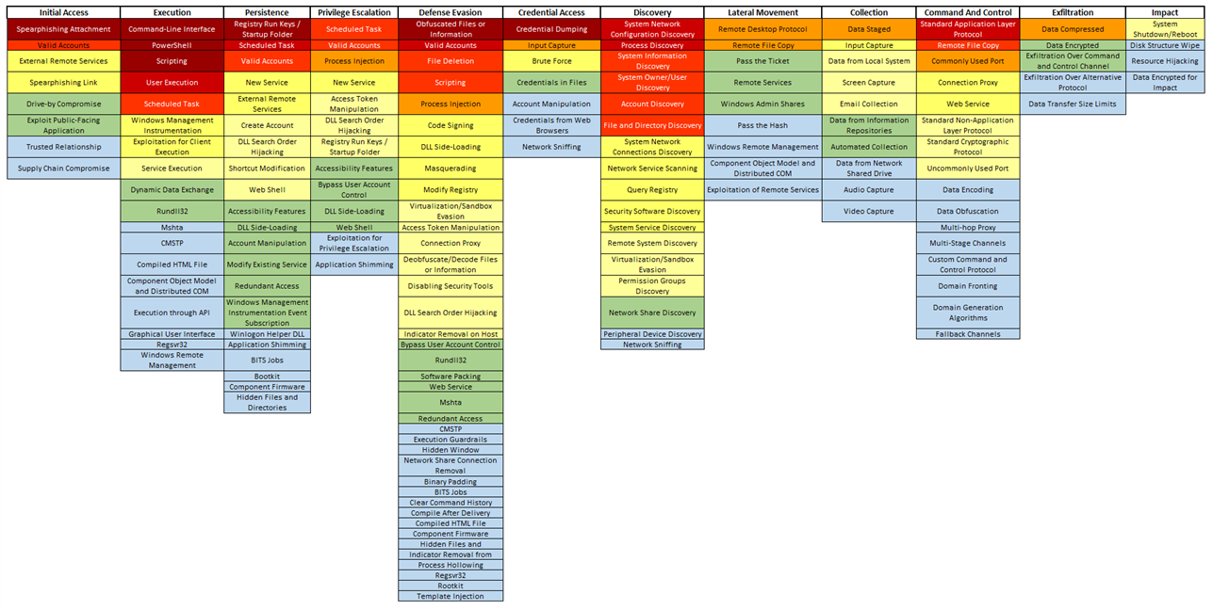
MITRE ATT&CK : Techniques mostly used to attack aviation
TLP:GREEN
Notes:
Old version used on purpose

Slide 7
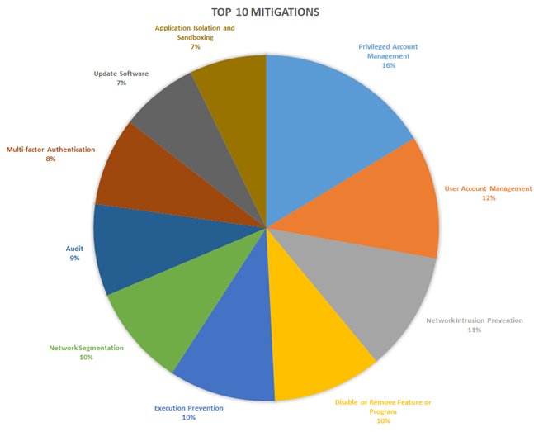
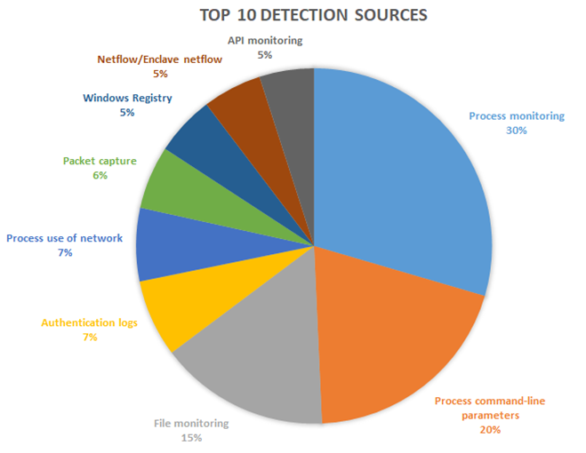
Top 10 Mitigation Means
Top Detection Means
TLP:GREEN

Slide 8
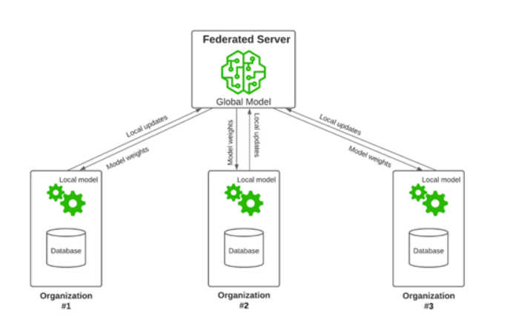
Improving the attribution of cyber-attacks?
Why
To anticipate attacks using similar techniques by similar threat actors
To prioritise protection, detection and mitigation means
How
AI/ML app trained on aviation related cyber-incidents
Challenges
Data cannot be shared (sensitive)
No one wants to host such sensitive info
Solution => Federated learning
Federated learning applies to other fields than cyber

Slide 9
EATM-CERT knowledge database: dedicated LLM
Wouldn’t it be nice if ChatGPT knew your industry information and if you could interact with it ?
Project :
Create an industry specific knowledge base with whom we could interact
Data:
Knowledge should come from internal documents
How:
Fine tune an existing model ?
Fine tuning pros :
Customization : Model performance increase for targeted application
Task specificity: More accurate and contextually relevant responses
Reduce data requirements
Fine-tuning cons:
Loss of generalization
Data annotation & collection : task specific labeled data which takes time to collect and annotate
Dependency on pre-trained Model
Making the model forget data or make them irrelevant

Slide 10
RAG architecture (Retrieval-Augmented Generation)
RAG is a combination of retrieval based and generative approaches. Which create a hybrid model that leverages external knowledge sources during the generation process
2 components :
Retriever : fetch relevant info of context from DB
Generator : takes the retrieved info and generates a coherent response
Key advantages
Improved contextual understanding
Enhanced fact-based QA
Knowledge integration
Flexible retrieval
Notes:
Improved Contextual Understanding: By incorporating external knowledge sources, the RAG model can better understand and respond to questions or queries in a more contextually relevant manner.
Enhanced Fact-Based Question Answering: RAG models are well-suited for fact-based question answering tasks where answers are drawn from factual information available in documents or knowledge bases.
Knowledge Integration: RAG models can integrate information from diverse sources, making them useful for tasks that require a broader knowledge base than what is present in the pre-trained model.
Flexible Retrieval: The retriever component can be customized to work with different types of knowledge bases, allowing flexibility in the choice of external data sources.

Slide 11
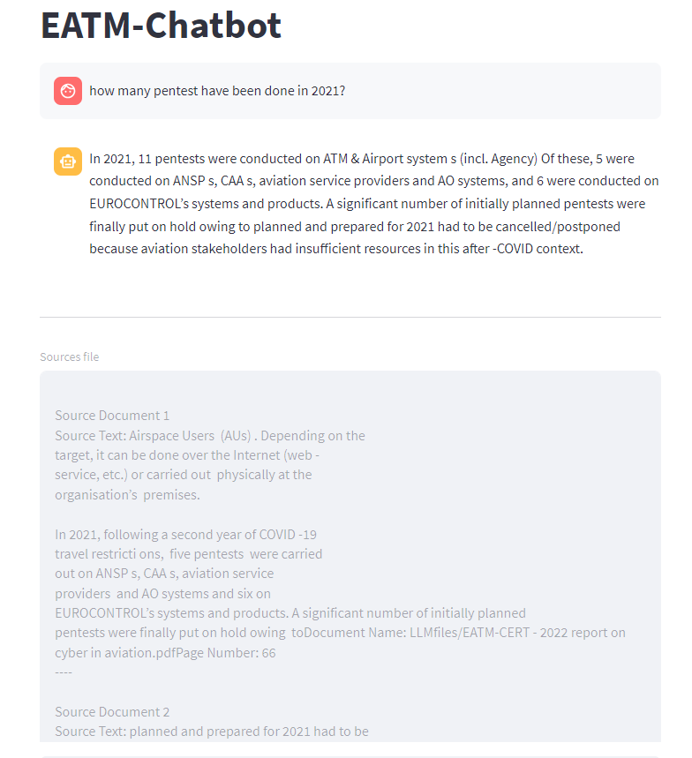
Knowledge database: dedicated LLM
We can upgrade model easily
No security issue
100% Local no API

Slide 12
Knowledge database: overview
Notes:
This approach allow us to upgrade and change model whenever we want
Everything is local and no security issue like this
We can also see how the model constructed his responses

Slide 13
AI for cyber - summary
Increase
productivity
Save resources
Focus on adding value
Challenge completeness
Conduct “undone/impossible”
analyses
Dedicated knowledge database

Slide 14
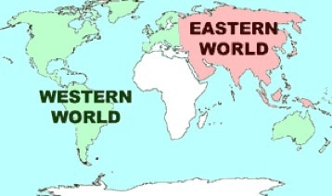
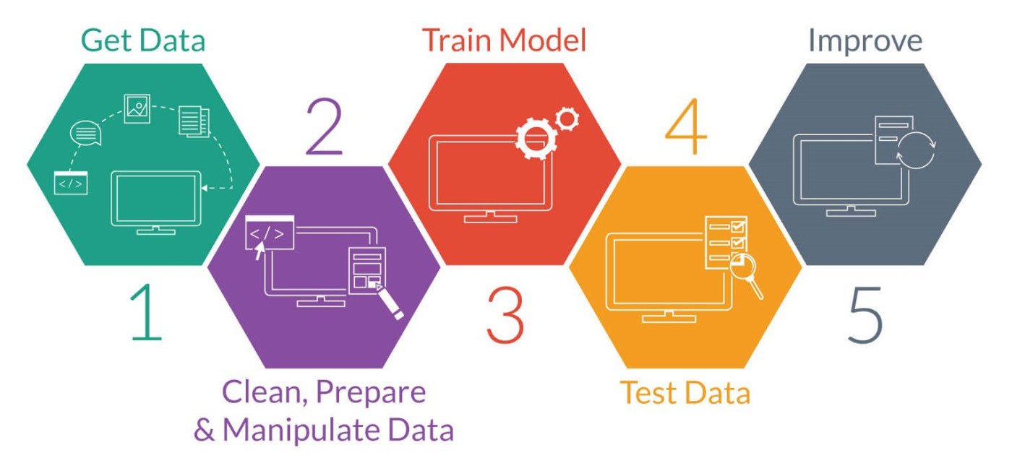
AI = yes, however, some challenges
Sensitivity
Corruption
Biased view
Don’t trust
blindly
Amount and variety of data to train models
Data sharing

Slide 15
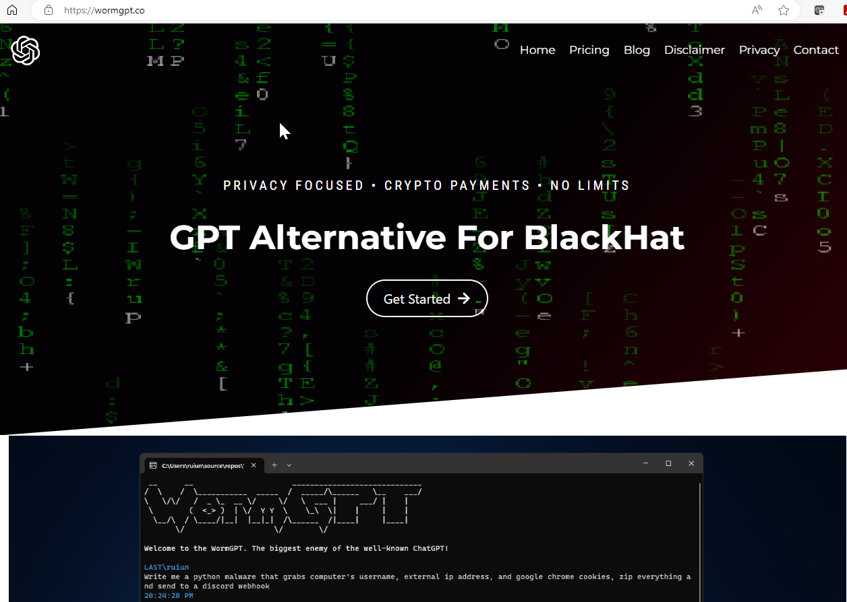
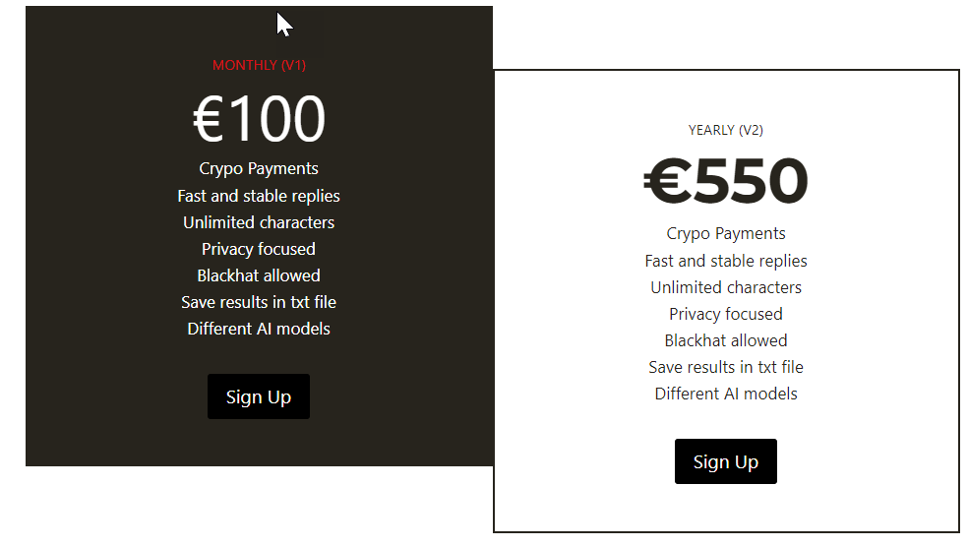
AI for cyber: also a threat
More sophisticated attacks
Reduced cost to produce a cyber-attack
More accessible
… and it’s only the beginning

Slide 16
THANK YOU
patrick.mana@eurocontrol.int
eatm-cert@eurocontrol.int

Slide 17
SUPPORTING EUROPEAN AVIATION

